Slide 1

WEEK 2
18th AUGUST – 25TH AUGUST
RUT CHOLERA
EMP CODE: 655095

Slide 2
18th - 21st august
Agile and Business analysis
Communication ethics
Analyzing requirement analysis
Project management
Waterfall model vs agile methodology
Sprints
Scrums

Slide 3
22nd august
DBMS
SQL
Normalisation
Joins
Types of joins
Fetching data from multiple tables
Subquery

Slide 4
23rd august
Testing
Importance of software testing
Phases of STLC
Automation
Static,dynamic testing
Unit testing
Whitebox, black box testing

Slide 5
24th august
Cloud computing
Introduction to cloud computing
Cloud service models and architecture
SAAS software as a service
Virtual machines intro
Cloud storage
Intro to ms azure

Slide 6
25th august
Devops CI-CD
Handson creating in VM and ssh
Devops life cycle
CI continuous integration
CD continuous deployement
Github, intro
Actions of github, usability

Slide 7
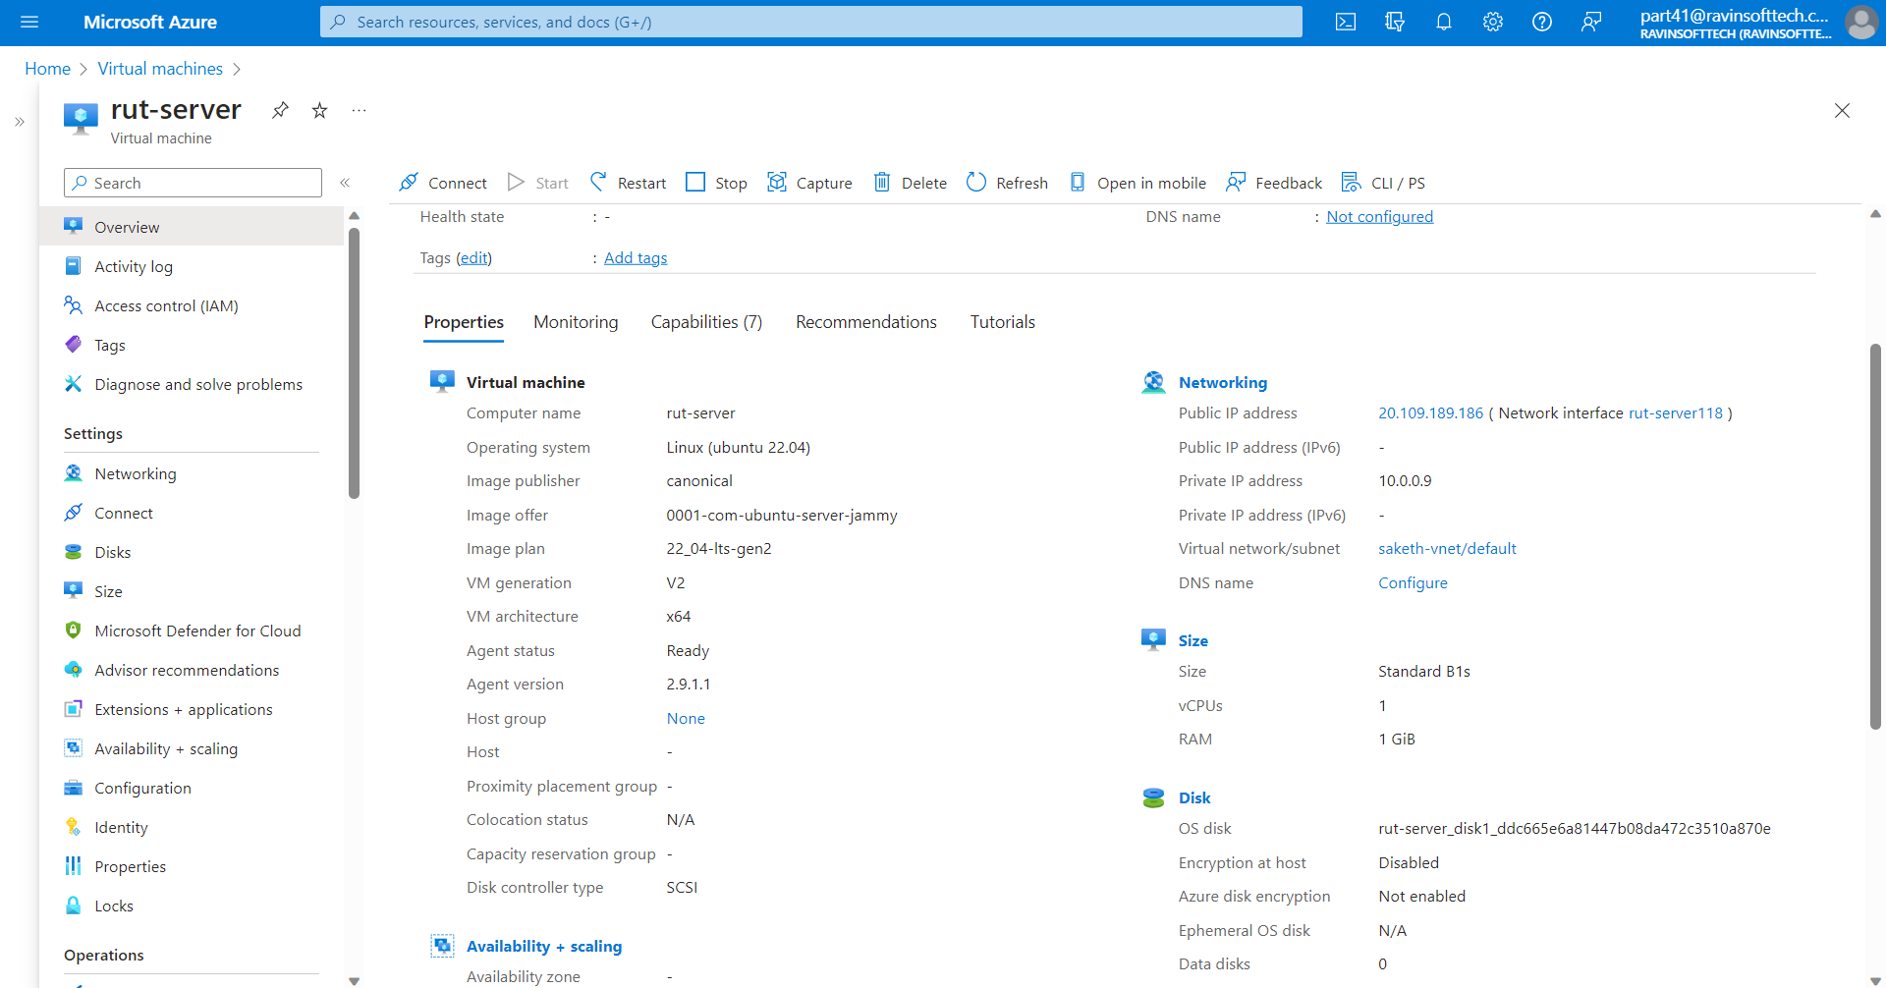

Slide 8
THANK YOU

